Slide 1
Team Are We There Yet
Design Presentation

Slide 2
Introduction
Project Mission
Play the game “Simon” for 15 seconds
Pick up a playing card and carry it across the finish line
Twist one row of a Rubik’s cube 180 degrees
Draw “IEEE” on an Etch-A-Sketch
Line follow
Complete round in 5 minutes or less

Slide 3
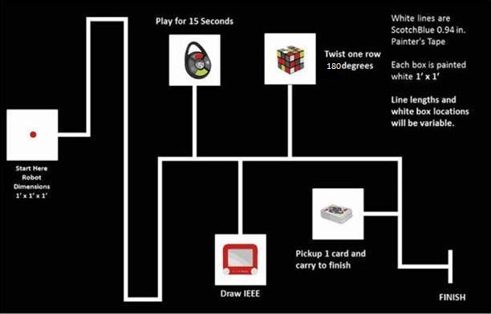
Competition Course

Slide 4
Timeline
18 September 2014 – Preliminary Requirements
10 October 2014 – Preliminary Budget
18 November 2014 – Integrated Prototype
25 November 2014 – Revised Requirements
12 December 2014 – Preliminary Design Document

Slide 5
Budget
Proposed budget: $654.52
Total spent: $560.21

Slide 6
Design Solution
Process
Identify when light in starting area goes out
Line follow to first challenge
Complete challenge
Line follow to second, third and fourth challenges, completing each
Cross finish line

Slide 7
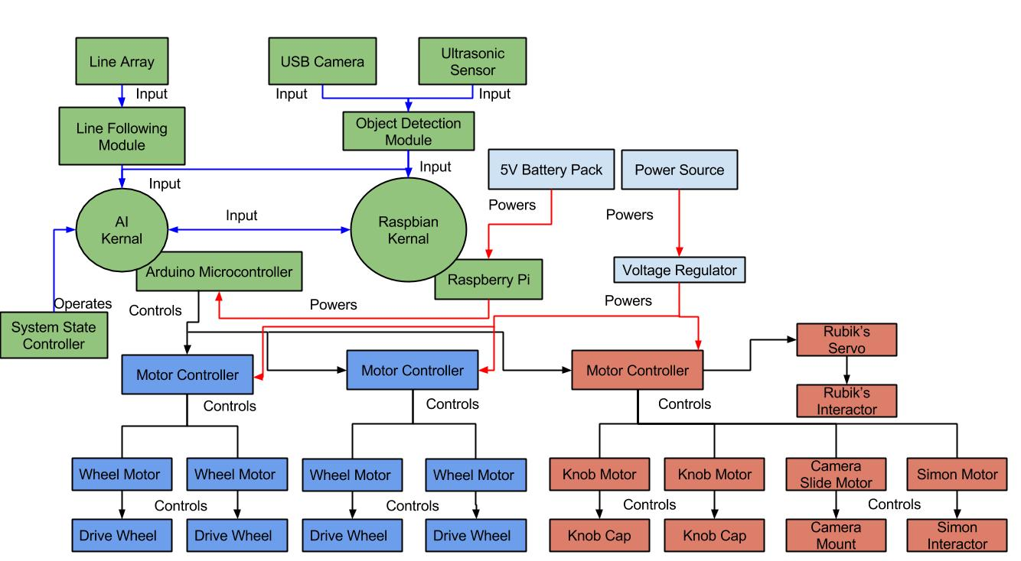
System Architecture

Slide 8
Design Considerations
Assumptions and dependencies
Operation
Rule changes
General Constraints
Size
Power consumption
Safety Constraints and Considerations
Electrical hazards
System heating

Slide 9
Subsystems
Coordination Subsystem
Reads input from sensors
Directs other subsystems
Movement Subsystem
Contains all components responsible for moving system
Challenge Subsystem
Contains all components responsible for completing challenges

Slide 10
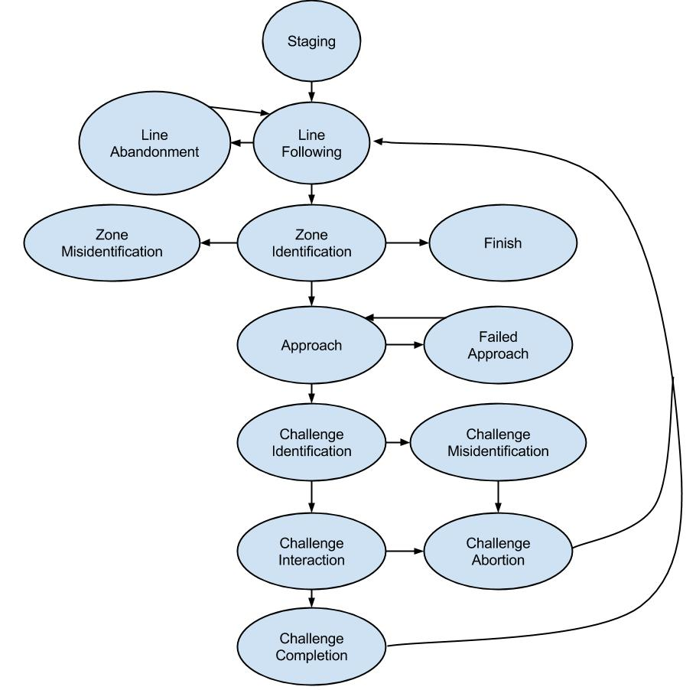
Coordination Subsystem
Purpose
Progresses system through state diagram
“Master” of system
Responsibilities
Read input from sensors
Interpret sensor reading
Activate corresponding subsystem

Slide 11
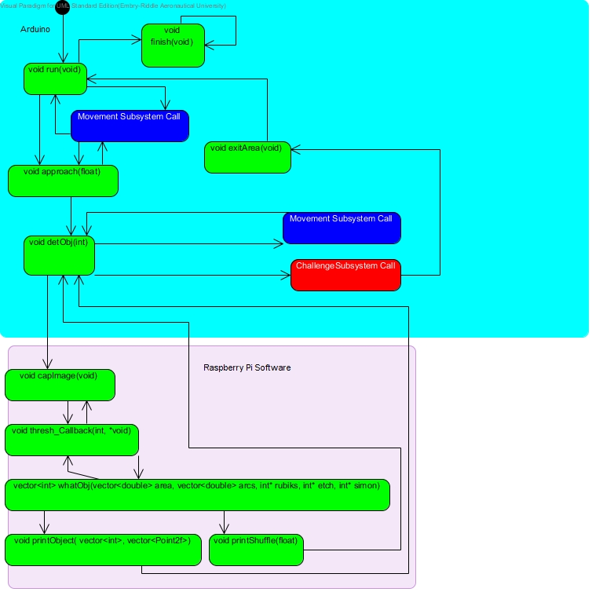
Functional Diagram

Slide 12
Parts List
Raspberry Pi B+
Arduino Mega 2560
QTR-8A Line Sensor Array
USB Camera
Ultrasonic Sensor

Slide 13
Movement Subsystem
Purpose and Responsibility
Performs all movement operations
Motors and wheels
Chassis
Constraints
Fit within starting area
Maintain contact with course floor

Slide 14
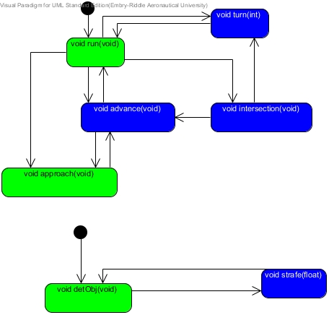
Functional Diagram

Slide 15
Parts List
4 Nema 16 Stepper Motor
Wooden Chassis
Mecanum Wheels
5000mah 14.8V LiPo Battery
Adjustable Voltage Regulator
2 Adafruit Motor Shields

Slide 16
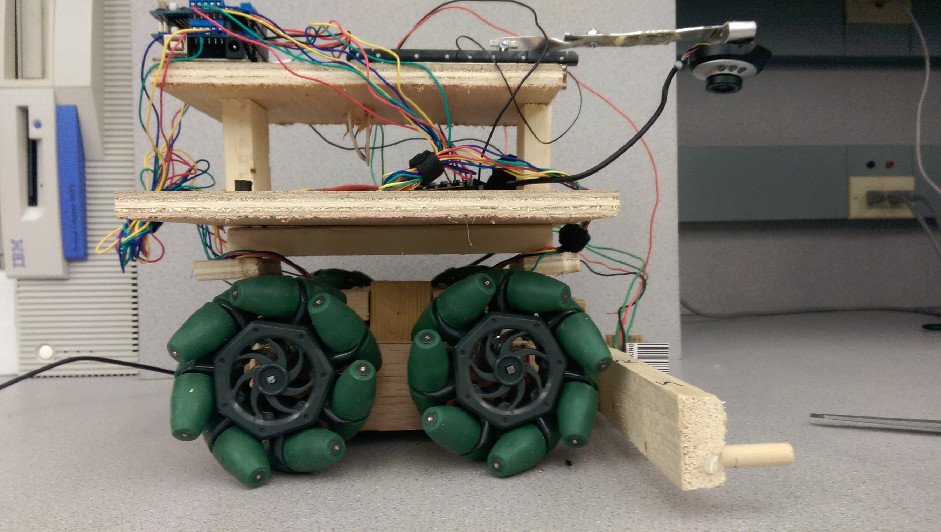
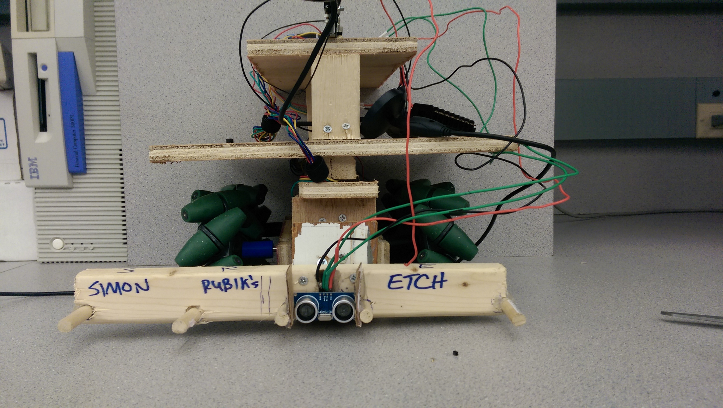
Chassis
2 tiers
(weight)
(dimensions)

Slide 17
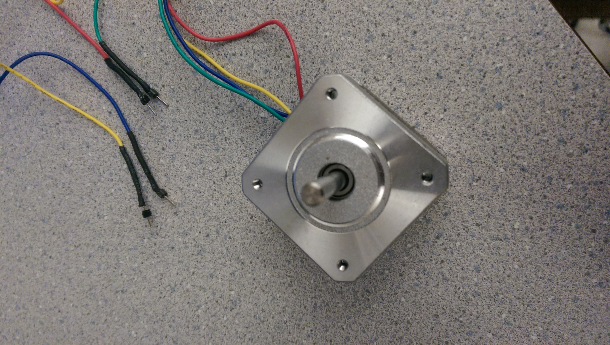
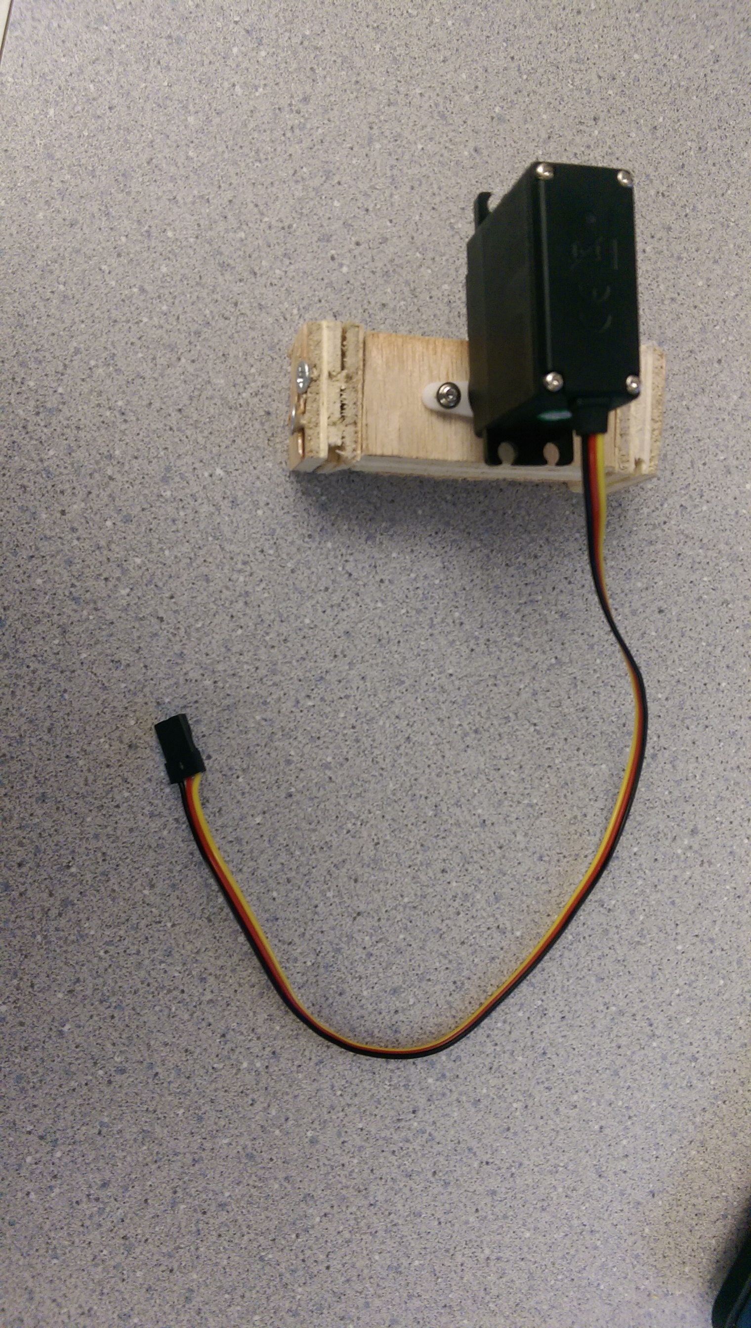
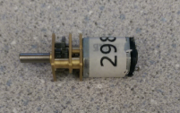
Motors
4 Stepper Motors
3 DC Motors
1 Servo

Slide 18
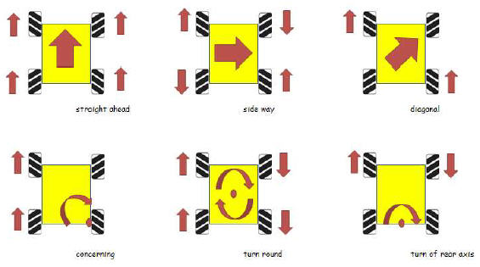
Wheels
Mecanum Wheels
Source: Humanoid Robotics

Slide 19
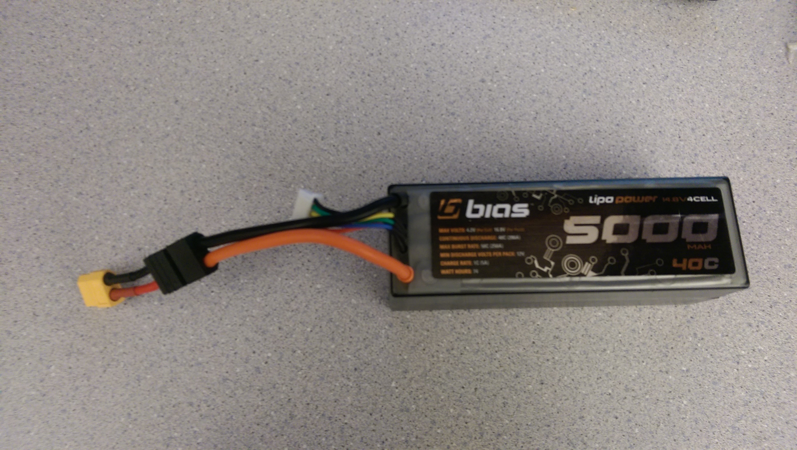
Battery
14.8 V Four cell lithium polymer battery.
USB battery.

Slide 20
Challenge Subsystem
Purpose and Responsibility
Efficient and accurate completion of challenges.
Constraints
Challenge modules must fit within space allotted by chassis.

Slide 21
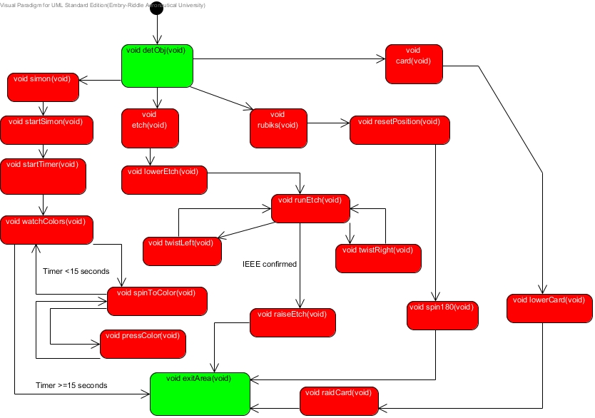
Functional Diagram

Slide 22
Parts List
Servo motor
Lumber
3D printer filament
3 DC motors
Stepper motor
Photoresistors

Slide 23
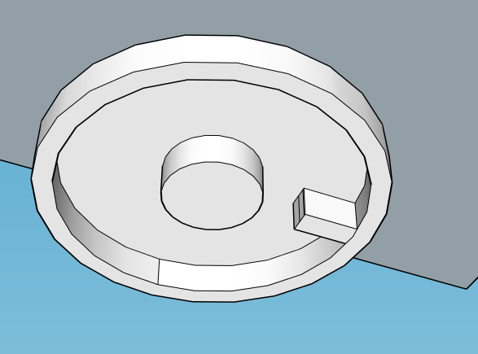
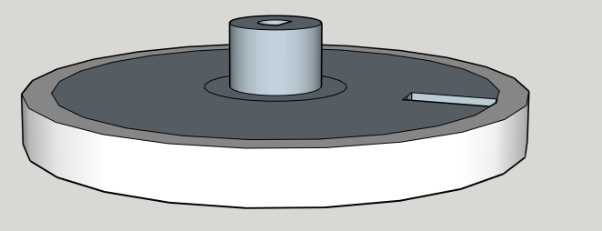
Simon Interactor
Photo resistors to detect the lights on the game.
Rotate 360 degrees with small DC motor.
Pushing motion with stepper motor

Slide 24
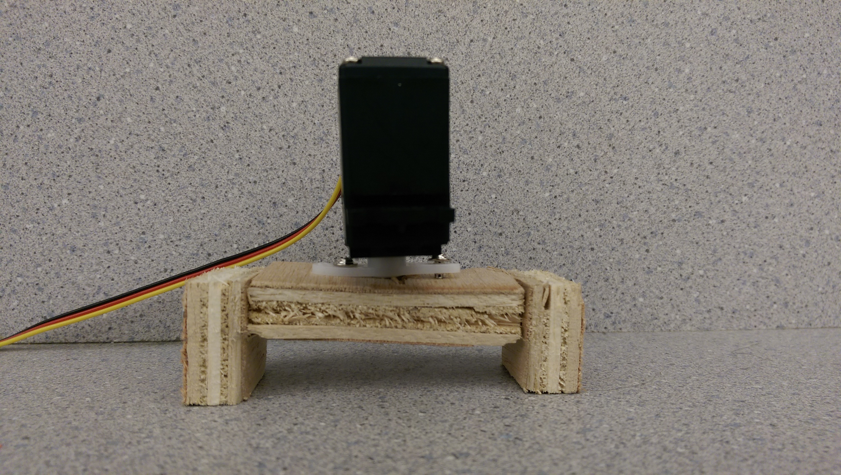
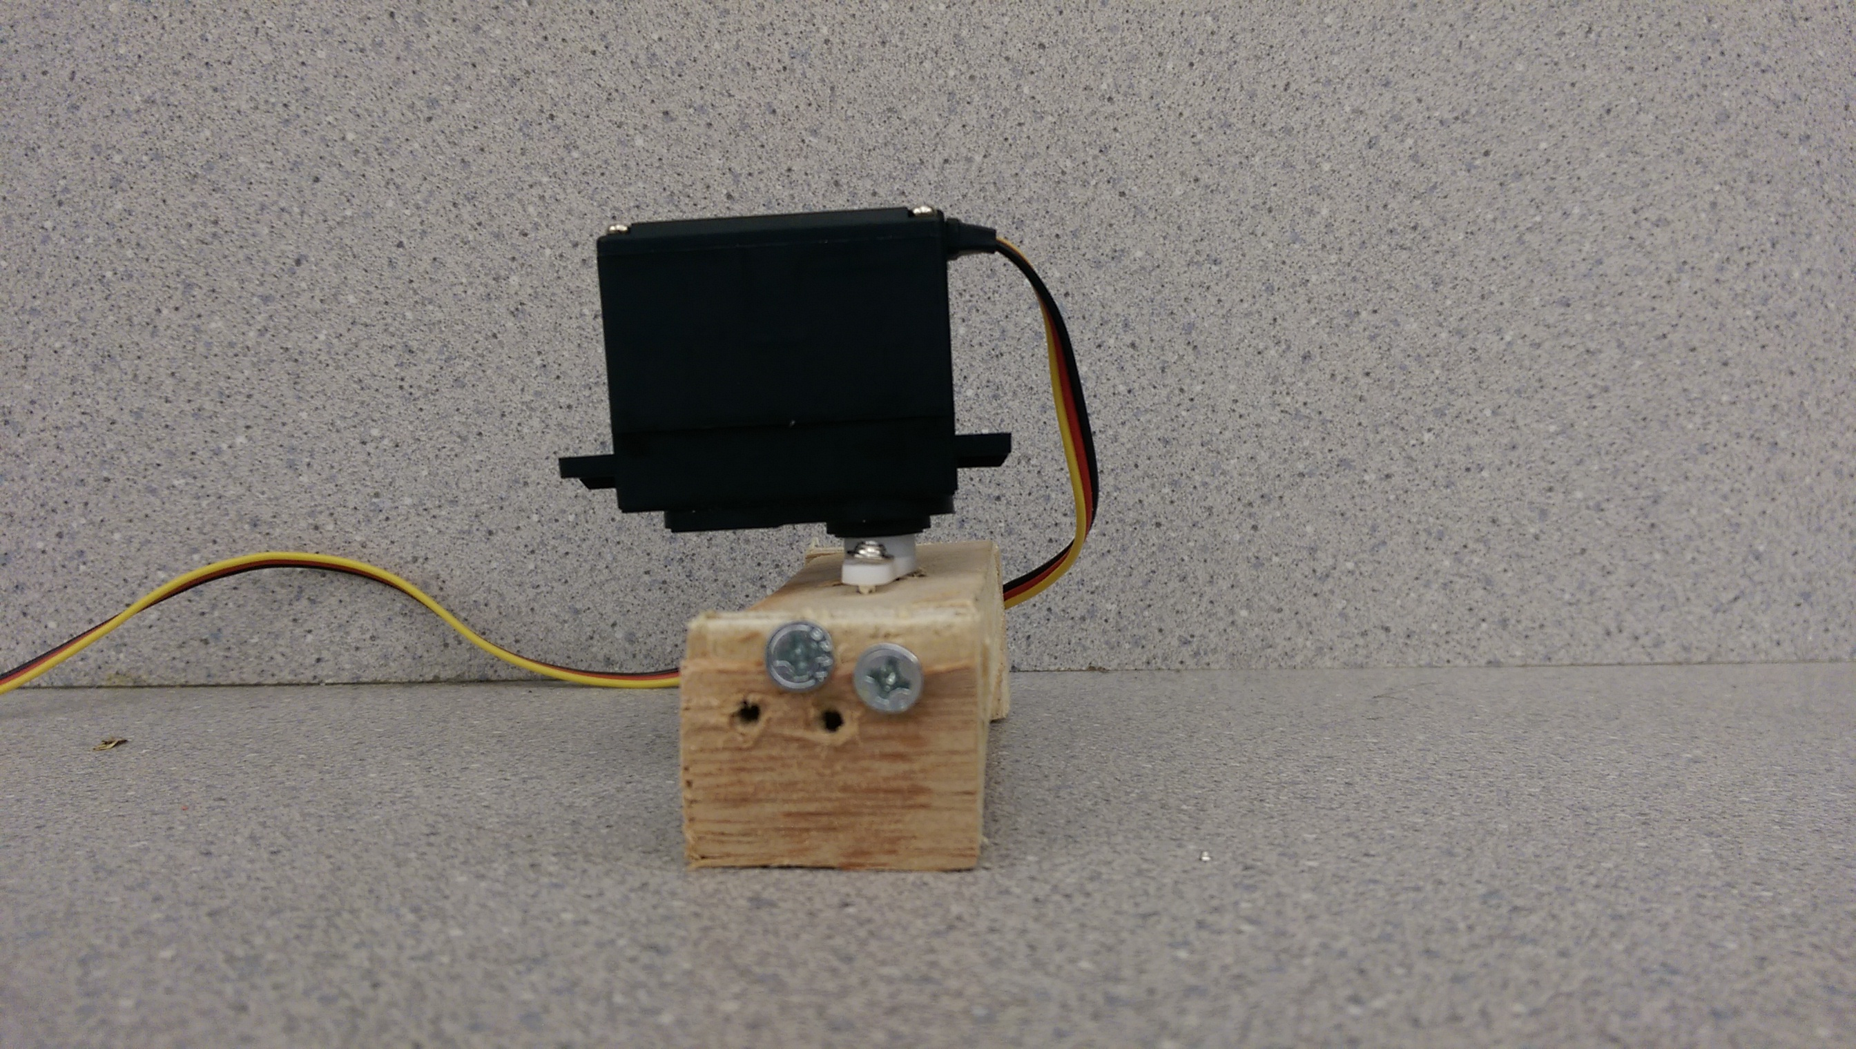
Rubik’s Cube and Card Interactor
180 degree servo attached to wooden attachment.
Grips top row of cube and rotates.

Slide 25
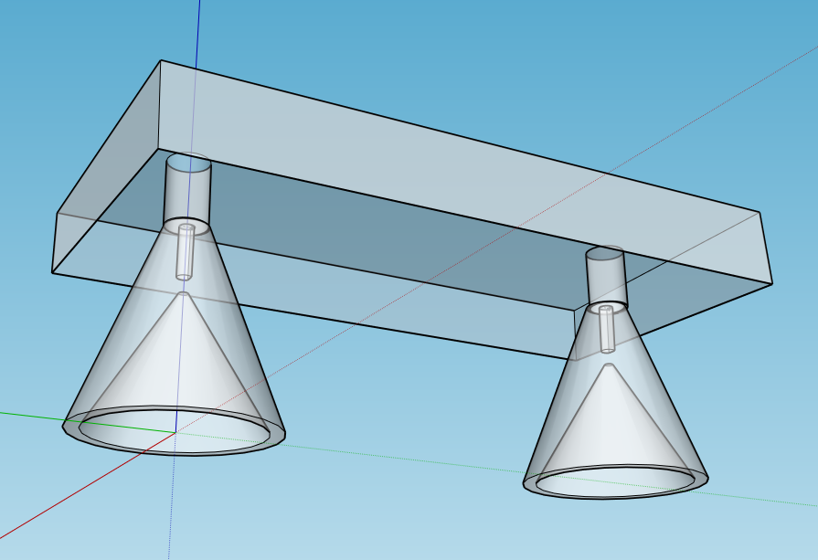
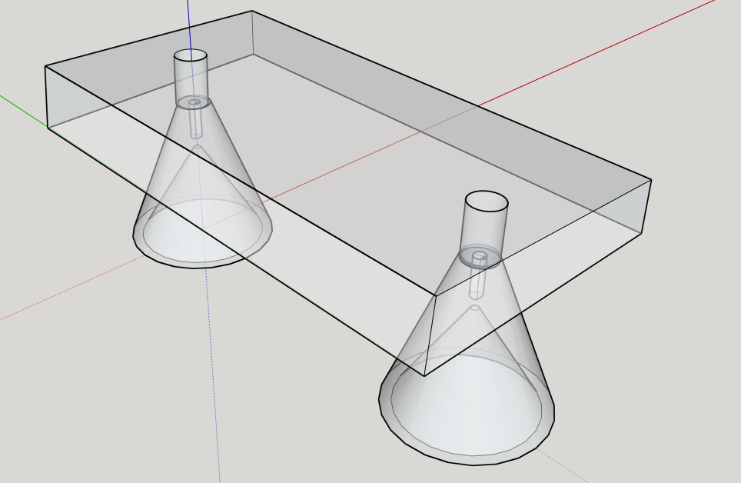
Etch-A-Sketch Interactor
Conical caps attached to two small DC motors.
Each knob will turn one knob on the Etch-a-Sketch

Slide 26
Video of Performance

Slide 27
Semester Re-cap
Accomplishments
Goals for next semester
Refine course movement
Simon and Etch-A-Sketch Challenge modules

Slide 28
References
http://www.humanoid-robotics.com/products.php?product=Robot-Kit-with-Mecanum-Wheels

